Slide 1
Cornell University
Nutrient Management Spear Program
2025 New York Soil Test Conversion Program
3-31-2025
Contacts:
qmk2@cornell.edu (Quirine) kw566@cornell.edu (Kirsten)
Nutrient Management Spear Program (NMSP)

Slide 2
Cornell University
New York Soil Test Conversion Program
New Initiative in 2025:
With new soil testing labs marketing and offering services to CAFO Permitted farms in New York, in partnership with state agencies NYSDEC, NYSAGM and NY NRCS, the Nutrient Management Spear Program is embarking on a 2025 New York Soil Test Conversion Program for existing and new laboratories to further collaborate on developing conversion equations to Cornell Morgan equivalents for nutrient management planning via the NRCS-NY 590 conservation practice standard.
Nutrient Management Spear Program (NMSP)

Slide 3
Cornell University
New York Soil Test Conversion Program
Steps:
Collect 230-250 soil samples, representing 40-50 soil types and all major soil groups across New York
5-gallon (full) buckets
0-8 inches depth (collect with a spade…)
Georeferenced location
Field history form (crops, manure history, drainage, cover crops, tillage, etc.)
Transport to NMSP at Cornell; team will dry and grind samples and subsample and create batches for participating lab
Each sample will be analyzed for soil pH, buffer pH, soil organic matter (500ºC), and Morgan extractable P, K, Ca, Mg, Mn, Fe, Al, B, and Zn. S could be added if labs agree. All lab results will be compared to these.
Nutrient Management Spear Program (NMSP)

Slide 4
Cornell University
New York Soil Test Conversion Program
Participating labs will share analytical protocols implemented in the lab for record keeping and analyze samples using their standard method (e.g. Mehlich-3, Modified Morgan, or Morgan) and analyze for soil pH, buffer pH, soil organic matter, P, K, Ca, Mg, Mn, Fe, Al, B and Zn (and S if they would like to)
Each participating lab will receive a set of comparisons for the analytical method that they participate with. This could be more than one method per laboratory
A master conversion equation tool will be developed and made available through the NMSP website
Nutrient Management Spear Program (NMSP)

Slide 5
Cornell University
New York Soil Test Conversion Program
Ontario/Erie/St Lawrence-Lake Champlain Plains- High Lime Glacial Till (MLRAs 101, 142) | Ontario/Erie/St Lawrence-Lake Champlain Plains- Acid Glacial Till (MLRAs 101, 142) | Ontario/Erie/St Lawrence-Lake Champlain Plains- Glacial Till (MLRAs 101, 142) | Ontario/Erie/St Lawrence-Lake Champlain Plains-Glacial Lacustrine/Marine/Glacial fluvial/Deltaic Sediments (MLRAs 101, 142) | Ontario/Erie/St Lawrence-Lake Champlain Plains- Outwash (MLRAs 101, 142)
A. Well and Moderately Well Drained | A. Well and Moderately Well Drained | A. Well and Moderately Well Drained | A. Well and Moderately Well Drained | A. Well and Moderately Well Drained-High pH
Honeoye | Madric | Ontario | Colonie | Arkport
Lima | Schroon | Bombay | Collamer | Howard
Hogansburg |  | Farmington | Hudson | Palmyra
 |  |  | Williamson
 |  |  | Vergennes
B. Somewhat Poorly and Poorly Drained | B. Somewhat Poorly and Poorly Drained | B. Somewhat Poorly and Poorly Drained | B. Somewhat Poorly and Poorly Drained | B. Somewhat Poorly and Poorly Drained
Ovid | Orpark | Angola | Minoa | Swanton
Appleton |  |  | Muskellunge
 |  |  | Niagara
 |  |  | Rhinebeck
 |  |  | Raynham
Dan Ufnar, State Soil Scientist NRCS
Nutrient Management Spear Program (NMSP)

Slide 6
Cornell University
New York Soil Test Conversion Program
Lake Erie-Allegany Plateaus/Catskills- Acid Glacial Till (MLRAs 139, 140) | Lake Erie-Allegany Plateaus/Catskills- Acid Outwash (MLRAs 139, 140) | Hudson Valley/Long Island Till (MLRAs 144a, 149B) | Hudson Valley/Long Island Outwash (MLRAs 144a, 149B) | Alluvium (All MLRAs)
A. Well and Moderately Well Drained | A. Well and Moderately Well Drained | A. Well and Moderately Well Drained-Acid | A. Well Drained-Acid | A. Well Drained-Acid
Bath | Chenango | Bernardston | Riverhead | Barbour
Lewbeach | Tunkhannock | Pittstown
Lordstown |  | Montauk
Mongaup |  | Oakville
Chautauqua
Willowemoc
B. Somewhat Poorly and Poorly Drained |  | A. Well and Moderately Well Drained |  | B. Well Drained
Busti |  | Stockbridge |  | Hamlin
Fremont |  |  |  | Tioga
Volusia
Dan Ufnar, State Soil Scientist NRCS
Nutrient Management Spear Program (NMSP)

Slide 7
Cornell University
New York Soil Test Conversion Program
To get a range in fertility levels, per soil series:
Low to medium P (<9 lbs/acre)
optimum P (9-19 lbs P/acre)
high P (20-39 lbs P/acre)
Very high P (40-80 lbs P/acre)
Very high (>80 lbs P/acre)
Select whatever you think you could collect (enter on google doc)
https://docs.google.com/spreadsheets/d/13MNd_wo0ppuBsX-hX2dbSsaQCh_niJwQ/edit?usp=sharing&ouid=116910914563647058489&rtpof=true&sd=true
Nutrient Management Spear Program (NMSP)

Slide 8
Field History Form
Cornell University
Project instructions:
http://nmsp.cals.cornell.edu/Announcements/SoilSampling_ProjectDes cription_3_31_2025.pptx
http://nmsp.cals.cornell.edu/Announcements/SoilSampling_ProjectDes cription_3_31_2025.pdf
Please include a completed field history form for each bucket you collect for this project. The field history form asks for rotation information, field management, and manure history.
http://nmsp.cals.cornell.edu/Announcements/SoilSampling_Blank_Field History_3_31_2025.docx
http://nmsp.cals.cornell.edu/Announcements/SoilSampling_Blank_Field History_3_31_2025.pdf
Nutrient Management Spear Program (NMSP)

Slide 9
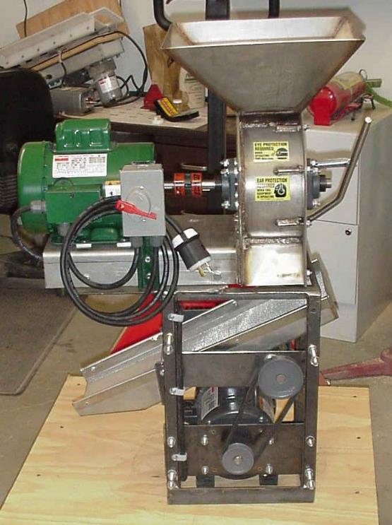
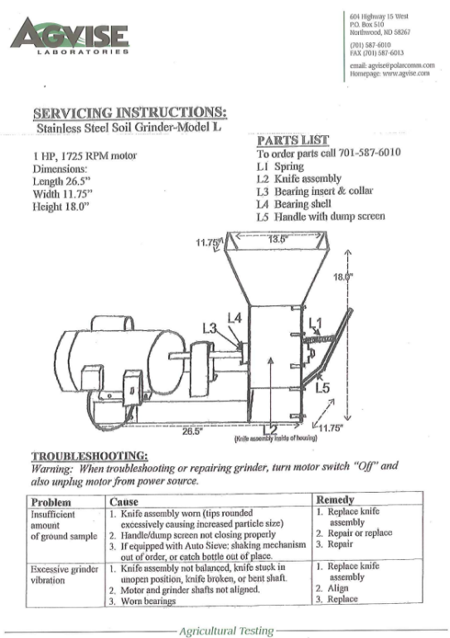
Cornell University
New York Soil Test Conversion Program
Labs with confirmed interest:
Dairy One
Waypoint
Spectrum
Integrated Ag Services
Radical Agronomics
Maine
Penn State
Additional labs welcome!
Nutrient Management Spear Program (NMSP)

Slide 10
Cornell University
Nutrient Management Spear Program
2025 New York Soil Test Conversion Program
For questions:
qmk2@cornell.edu (Quirine) kw566@cornell.edu (Kirsten)
Nutrient Management Spear Program (NMSP)

